Slide 1



2026 District 8 Tournament Rules
Welcome!

Slide 2
2026 District 8 Tournament Rules
WHY the international tournament is part of the Little League Program:
Little league is a program of service to youth. It is geared to provide an outlet of healthful activity and training under good leadership in the atmosphere of wholesome community participation. The movement is dedicated to helping children become good and decent citizens. It inspires them with a goal and enriches their lives towards the day when they must take their places in the world. It establishes the values of teamwork, sportsmanship, and fair play.
Notes:
Note:

Slide 3
2026 District 8 Tournament Rules
The tournament season is the most visible part of the Little League Program. When we all understand WHY the Little League Program exists and demonstrate that purpose through our actions, we have the potential to affect how a new generation sees Little League Baseball and Softball.
Every tournament game is an opportunity for us to demonstrate WHY the Little League Program exists. The more of us that strive to change the culture of youth baseball/softball to focus on teamwork, sportsmanship, and fair play, the greater the impact we will have.
Notes:
Note:

Slide 4
2026 District 8 Tournament Rules
Diamond Leader Training
Baseball and Softball (Tournament Play) – Managers and Coaches: Requires all tournament managers and
coaches to complete the Little League Diamond Leader Training Program (LittleLeague.org/DiamondLeader)
Certificate must be in your Tournament Affidavit Book.
  Last years is still good.
Notes:
Note:

Slide 5
2026 District 8 Tournament Rules
Abuse Awareness Training
All volunteers must complete the Abuse Awareness Training mandated by Little League. (Please use the updated link for Little League Training)
  https://www.littleleague.org/university/articles/abuse-awareness-training-course/
Certificate must be in your Tournament Affidavit Book.
  Use the Little League Website to complete.
  Updated for 2026 Season
Notes:
Note:

Slide 6
2026 District 8 Tournament Rules
Significant Updates
Baseball and Softball – Tournament Rule 3 (b) – Illegal Bats: Reworded to provide consistency with Rule 6.06(d).
In all Tournament levels and divisions, a batter is out for illegal action when the batter enters the batter’s box with one or both feet entirely on the ground with an illegal bat (see bat specifications Rule 1.10) or is discovered having used an illegal bat prior to the next player entering the batter’s box. The ball is dead. Runners must return if they advanced on the play.
NOTE: If the infraction is discovered before the next player enters the batter’s box following the turn at bat of the player who used an illegal bat:
1. The ball is dead, the batter is out, and runners must return if they advanced on the play. The manager of the defense may advise the plate umpire of a decision to decline this part of the penalty and accept the play. Such election shall be made immediately at the end of the play.
2. The manager of the team will be ejected from the game, the batter who violated the rule will be ejected from the game, and the offensive team will lose one eligible base coach for the duration of the game.
Notes:
Note:

Slide 7
2026 District 8 Tournament Rules – Mandatory Play
  Replaced with mandatory use of continuous batting order.
  Continuous batting order is required. Players may be entered or re-entered defensively at any time
  If a player is injured, becomes ill, or must leave the game site after the start of the game, the team will skip over him/her when his/her time at bat comes up without penalty. If the injured, ill, or absent player returns, he/she is merely inserted into their original spot in the batting order and the game continues.
  If a player is unable to complete a plate appearance due to injury, illness or ejection, the next batter in the lineup shall take his/her place at the plate and assume the count of the original batter.
  Mandatory play does not apply to Senior League.
  Any player who has been removed for a sub may re-enter in the same position in the batting order. Substitute may not re-enter.
Notes:
Note:

Slide 8
2026 District 8 Tournament Rules –
Number of Players
Teams MUST have 12 Players or DA approval to carry less!
First Game –
12 players should be in attendance (when the affidavit becomes official). If a player is missing for illness or other justifiable reason, play on.
If any players have been removed from the roster (crossed out) – DA or TD must call the protest line.
Teams must have at least 9 players to start the game
  The game is considered started at the plate meeting
Teams must have at least 9 players to continue the game
If, at any time, a team has less than 9 players, the game will cease and be referred to the tournament committee.
Notes:
Next Slide is Brett

Slide 9
2026 District 8 Tournament Rules – Uniforms
Regular Season Uniforms may be worn as Tournament Uniforms.
The Little League Official Shoulder Patch must be affixed to the upper left sleeve or centered on left chest on sleeveless uniform shirt in all division of play and may not be sublimated or screen-printed.
No part of the uniform shall include a pattern that imitates or suggests the shape of a softball/baseball.
All sleeves, on pitchers, do not need to be covered if one solid color and not white or gray. Can be worn on one or both arms and can be different colors
Pitcher cannot wear wrist bands (a wrist band play calling card is permitted on the non-pitching arm so long as it is of a solid, single color: black, white, gray, or uniform color. Play calling cards cannot be affixed to the belt).
Notes:
Note:

Slide 10
2026 District 8 Tournament Rules –
Other Rules
  All fields are considered neutral. The home team shall be determined by the toss of a coin.
  Rule 1 – Baseballs licensed by Little League with the “RS-T” designation must be used.
  Rule 3 - Players and coaches shall not address or mingle with spectators during a game.
  Rule 6 – Third Strike not caught applies to the 9/10/11, 10/11/12, Intermediate, Junior, and Senior Divisions (Baseball and Softball).
    1st base not occupied, 1st base occupied w/ 2 outs
    May attempt to advance until they enter the dugout or dead ball area
  Rule 6 – Batter is out when the batter enters the batter’s box with one or both feet entirely on the ground with an illegal bat or is discovered having used an illegal bat prior to the next player entering the batter’s box. Both the batter and the manager of the team will be ejected from the game. The offending manager is removed from the International Tournament.
  Managers or coaches are NOT permitted to warm up a pitcher at home plate or in the bullpen or elsewhere at any time, including in-game warm-up, pre-game warm-up, and in other instances, during tournament play!
Notes:
Note:

Slide 11
2026 District 8 Tournament Rules –
Run Rules
Majors and below:
  15 after 3, 2.5 if home is ahead
  10 after 4, 3.5 if home is ahead
Intermediate ->Sr.
  15 after 4, 3.5 if home is ahead
  10 after 5, 4.5 if home is ahead
No 8 run after x during Tournament
Notes:
Note:

Slide 12
2026 District 8 Tournament Rules –
Tie Games
Tie Game - When the completion of six innings (INT, JL, SL: seven innings), and the score is tied, the following tie-breaker will be played to determine a winning team:
*Starting in the top of the 7th (8th) inning, and each half inning thereafter, the offensive team shall begin its turn at bat with the player who is scheduled to bat last in that respective half inning being placed on second base.
  Example Batter 5 on the lineup card is up to bat. Batter 4 on the lineup card will be placed on 2nd.
Notes:
Note:

Slide 13
2026 District 8 Tournament Rules –
Between Innings
Pitcher has up to one (1) minute or up to eight (8) warm-up pitches
Managers/coaches are not allowed in fair ball territory –
  Mangers/coaches are not permitted to warm up the catcher
Base coaches must stay in their dugouts until catcher throws to 2nd base
– Rule 4.05 – Please do not say they did not make me do that during the regular
season.
Substitutions must be made through the game Umpire in Chief
Defensive substitutions must be made when the players go into the field
Offensive substitutions must be made immediately prior to the at bat (Seniors)
Offensive substitutions below Seniors - removal of sick or injured player, Courtesy runner, etc.
Notes:
Next Slide is Brett

Slide 14
2026 District 8 Tournament Rules –
Clarifying The Penalty
  Illegal Equipment – by rule illegal equipment is limited to the use of an illegal bat, which is a bat that:
    Does not meet the specification and/or requirements in 1.10
    Is modified or altered, such as the shaving and/or rolling of bats to improve performance.
    Does not include the use of products such as choke-knobs and choke-up assists.
      If it goes on the bat remove it, if it is on the hand, it is allowed
    PENALTY: the offending player and the offending manager are ejected, and the offending team will lose one eligible adult base coach for the duration of the game. Rule 3.01 – The offending manager is removed from the International Tournament.
  Improper Equipment – is not illegal equipment.
    Examples include a catcher’s mask without a dangling throat protector, skull caps, metal spikes in LL division and below, or choke-knobs and choke-up assists.
    Clarification:
      Improper equipment must be removed from the game once discovered and is not subject to immediate ejection as outline in Rule 3.01.
      Continued use of improper equipment after removal from the game is subject to ejection under Rule 9.01(b).
  Defective / Damaged Equipment: - is not illegal equipment.
    Example included a cracked batting helmet or one that is missing an earpad.
    Clarification:
      Defective or damaged equipment must be removed from the game once discovered and is not subject to immediate ejection as outline in Rule 3.01.
      Continued use of improper equipment after removal from the game is subject to ejection under Rule 9.01(b).
Notes:
Next Slide is Doug

Slide 15
2026 District 8 Tournament Rules –
Equipment Checks
  Managers are now responsible for all equipment checks!
  Managers will be asked at the plate meeting before each game if their equipment is proper and legal in accordance with Little League Internation rules / guidelines .
    You must provide a verbal Yes
  Use of illegal equipment (Bats) will result in an ejections of the manager and player using the illegal equipment.
  Items the Managers should be checking
    Helmets
    Bats
    Catcher’s gear
    No Old-style metal batting donuts!
Notes:
Next Slide is Doug

Slide 16
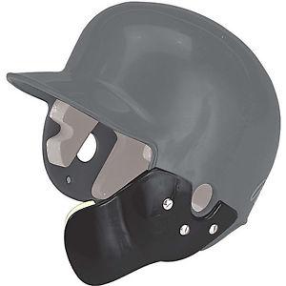
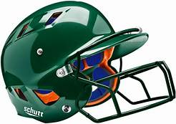
2026 District 8 Tournament Rules –
Helmets
Altering helmets in any way can void manufacturer’s warranty
Anything attached at time of purchase is approved
Stickers Limited to small number and size, less than 20% coverage of helmet. Not excessive, is not offensive, and no references to such things are drugs or alcohol!
Helmets may not
Be cracked
be repainted
contain tape or reapplied decals
have a mirror-like finish
Notes:
Next Slide is Doug

Slide 17
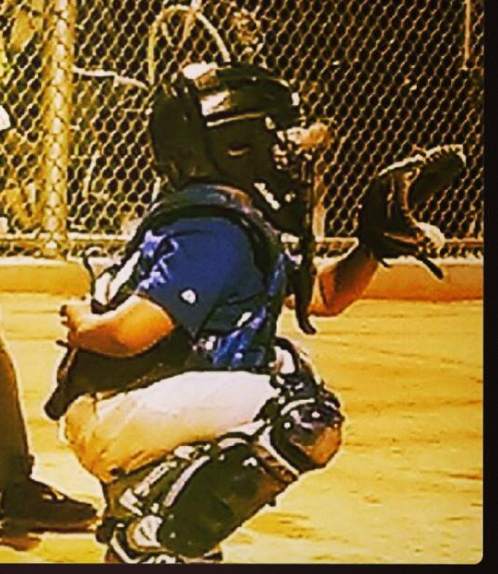
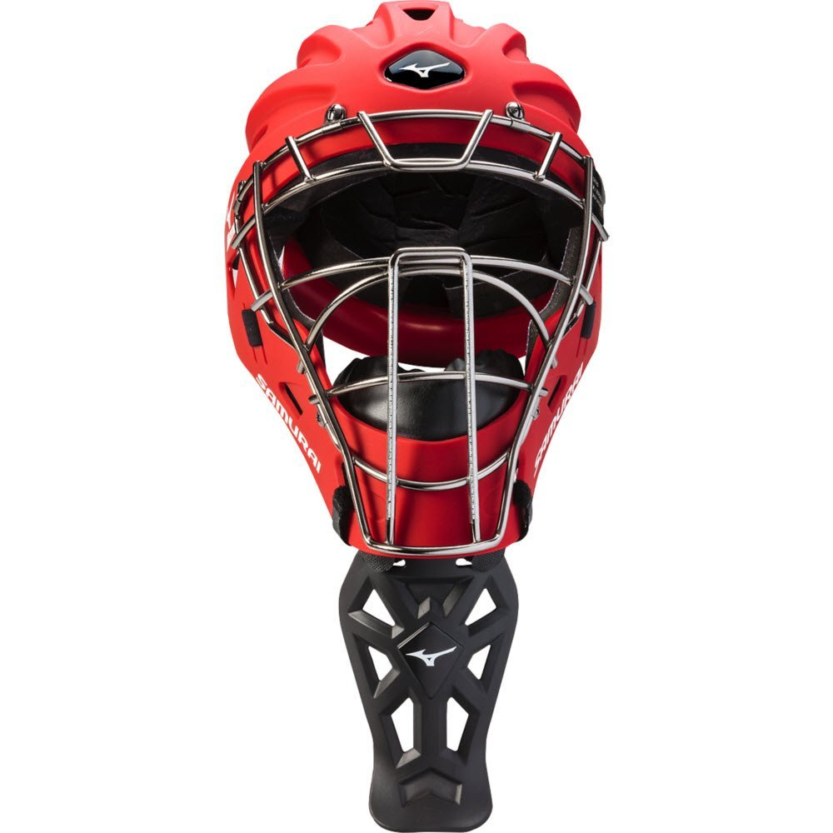
2026 District 8 Tournament Rules –
Dangling Throat Guards are required at all levels of play whenever a catcher’s mask is required
There are NO exceptions
This includes
Hockey mask style helmets
Masks with wire extensions
Catcher’s masks are required:
Any form of infield/outfield practice
Pitcher warm up
Games
Notes:
Next Slide is Brett

Slide 18


2026 District 8 Tournament Rules –
Baseball Bat Rules
Bat Restrictions –USA Baseball Standard!
LL Majors and Below
  Not more than 33 inches
  Not more than 2-5/8 inches in diameter
  No more BPF 1.15 bats
INT/JRs/SRs
  Not more than 34 inches for INT & JR
  INT/JR must meet USA Baseball standard or BBCOR standard
  Not more than 36 inches for SR
  Not more than 2-5/8 inches in diameter (no 2-3/4 bats)
  SRs, the bat must not weigh numerically more than three ounces less than the length of the bat (-3).
  SRs must meet BBCOR performance standard
Non-wood bats must have a grip of cork, tape, or composition material for a minimum of 10 inches.
Choke-knobs, choke-up assists, are considered alterations to the bat and are not permitted.
Thumb protectors are permitted as of 2026
If the certification mark on a bat is not legible, that bat cannot be used and shall be removed from the game.
Notes:
Note:

Slide 19

2026 District 8 Tournament Rules –
Softball Bat Rules
LL Majors and Below
  Not more than 33 inches
  Not more than 2-1/4 inches in diameter
  BPF of 1.20 or less
JR/SR
  Not more than 34 inches
  Not more than 2-1/4 inches in diameter
  BPF of 1.20 or less
Non-wood bats must have a grip of cork, tape, or composition material for a minimum of 10 inches.
Choke-knobs, choke-up assists are considered alterations to the bat and are not permitted.
Thumb protectors are permitted as of 2026
If the specification marks on a bat are not legible, that bat cannot be used and shall be removed from the game.
Notes:
Note:

Slide 20
2026 District 8 Tournament Rules –
Runners Explained
Below Seniors
With two outs, a “Courtesy Runner” may be used for pitcher or catcher of record. Runner must be the player in the batting order who made the last out.
If the pitcher or catcher made the last out, and the other is on base then the last out must be used.
If both the pitcher and catcher of record are on base with two out the player the made the first out is placed closest to home.
Every player must run the bases for their first time at bat.
Seniors
Pinch Runner – is a substitute.
Special Pinch Runner – (not a substitute) Twice in a game but not more than one time per inning, a team may utilize a player who is not in the batting order as a special pinch runner for any offensive player . A player may only be removed for a special pinch-runner one time during the game. The player for whom the pinch-runner runs is not subject to removal from the lineup. If the pinch-runner remains in the game as a substitute defensive or offensive player, the player may not be used again as a pinch-runner while in the batting order.

Slide 21
2026 District 8 Tournament Rules –
Rule 6.02 (Foot-in-Box Rule)
After entering the Batter’s Box, the batter must remain in the box with at least one foot throughout the at bat.
EXCEPTIONS:
  On a swing, slap, or check swing
  When forced out of the box by a pitch
  When the batter attempts a “drag bunt”
  When the catcher does not catch the pitched ball
  When a play has been attempted
  When time has been called
  When the pitcher leaves the dirt area of the pitching mound or takes a position more than five feet from the pitcher’s plate after receiving the ball or the catcher leaves the catcher’s box
  On a three ball count pitch that is a strike that the batter thinks is a ball
Penalty: The umpire shall warn the batter. After one warning, the umpire shall call a strike. Any number of strikes can be called on a batter.
AR: Only one warning needs to be issued per team before the umpire can start calling strikes for violation of this rule.
Notes:
Note:

Slide 22
2026 District 8 Tournament Rules –
Rule 6.08 Intentional Walk Rule
  Rule 6.08 (Intentional Walk Rule - All Divisions of Baseball and Softball.
  At any time during an at bat, the defense elects to “Intentionally Walk” the batter by announcing such decision to the plate umpire.
  Such notification must be made by the defensive manager. The manager must request and be granted “time” by the umpire and then inform the umpire of the defense’s intent to walk the batter.
  The ball is dead and no other runners may advance unless forced by the batter’s award. The appropriate number of pitches will be added to the pitch count.
  A player may only be intentionally walked by announcing such decision to the home plate umpire one time during the course of the game.
Notes:
Note:

Slide 23
2026 District 8 Tournament Rules –
Rule 7 - Base Awards
Base Awards (each runner including the batter/runner)
  3 bases if a fair ball is touched by detached equipment
  2 bases if a thrown ball is touched by detached equipment
  2 bases when a thrown ball goes out of play
    Time of pitch if throw is first play by an infielder
    Time of throw in all other cases
  1 base when a pitched ball goes out of play
  1 base if a fielder touches a pitched ball with detached equipment
  Batter is entitled to one base if hit by a pitched ball (not in the strike zone)
Notes:
Note:

Slide 24
2026 District 8 Tournament Rules –
Rule 8 Pitching (Baseball)
Under no circumstances shall a player pitch in three (3) consecutive days
The windup or set position may be used at any time
Illegal pitch with bases unoccupied shall be called a ball
There is no balk in LLB (Balk rules apply to Int/Jr/Sr)
A ball which slips out of the pitcher’s hands and crosses the foul line shall be called a ball, otherwise “no pitch” (Balk if runners are on base in Int/Jr/Sr)
Pitcher shall not bring his hand to his mouth while on the pitcher’s rubber – Penalty for this is a ball
Pitcher shall not deface the ball in any manner (penalty ball + warning)
Pitcher shall not intentionally pitch at the batter
8 warm up pitches or 1 minute between innings
Pitcher shall deliver the ball within 20 seconds (P: Ball)
Pitcher must be replaced on the 2nd visit in one inning , (8 to 10s - 3Rd visit in one inning)
Pitcher must be replaced on the 3rd visit in one game, (8 to 10s - 4th visit in one game)
Notes:
Note:

Slide 25
2026 District 8 Tournament Rules –
Rule 8 Pitching (Softball)
Both feet must be on the ground within or partially within the 24-inch length of the pitcher’s plate
The shoulders shall be in line with first and third base
Pivot foot shall be in contact with the pitcher’s plate, foot must be on or partially on the top of the surface of the pitcher’s plate. The non-pivot foot must be on or behind the pitcher’s plate.
The pitcher shall take the signal with the hands separated
  Pitcher must come to the pitcher’s plate with the hands separated
The pitcher shall hold the ball in one or both hands in front of the body for not less than 1 second and not more than 10 seconds before starting the delivery.
A backward step may be taken before or simultaneous with the hands being brought together. The pivot foot must remain in contact with the pitching plate at all times prior to the forward step.
The step must be forward and toward the batter within or partially within the 24-inch length of the pitcher’s plate.
The pitcher may not take the pitching position on the pitcher’s plate without having the ball in her possession.
Notes:
Note:

Slide 26
2026 District 8 Tournament Rules –
Rule 8 Pitching (Softball)
The pitcher must not make two revolutions of the arms in the windmill motion. A pitcher may drop the arm to the side and to the rear before starting the windmill motion.
The delivery must be an underhanded motion with the hand below the hip and the wrist not farther from the body than the elbow.
Leaping: The act of leaping while delivering a pitch in softball is a legal delivery. The pitcher may have both feet off the ground at the same time as long as both feet remain in the 24-inch width of the pitching plate and the pitcher does not replant the pivot foot.
Pushing off with the pivot foot from a place other than the pitcher’s plate is illegal. This includes a crow hop as defined under rule 2.00.
Pitcher must not make another revolution after releasing the ball.
Pitcher shall not deliberately drop, roll, or bounce the ball in order to prevent the batter from hitting it.
PENALTY: ILLEGAL PITCH
  All Division : Ball
Pitcher must be replaced on the 2nd visit in one inning , (8 to 10s - 3Rd visit in one inning)
Pitcher must be replaced on the 3rd visit in one game, (8 to 10s - 4th visit in one game)
Notes:
Note:

Slide 27
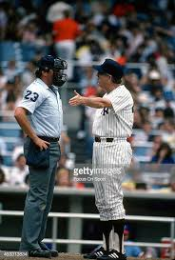
2026 District 8 Tournament Rules –
Appeal
Live Ball (Rule 7.10)
Re-touch
Missed base
Return to first base
Touch home base
Dead Ball (Rule 6.06/7)
Batting out of Turn
Illegal Bat
Notes:
Note:

Slide 28
2026 District 8 Tournament Rules – Proper procedure for Protest
Authority for Tournament play is vested solely in the Tournament Committee at Williamsport.
Protest or disputes which occur that cannot be settled by the Umpires or Tournament Director through immediate and concise application of the rules can be appealed through the chain of responsibility to the Tournament Committee
No protest shall be considered on decision involving an umpire’s judgement
Equipment which does not meet specifications must be removed from the game! Do not wait to bring it up until after the game has started! Asked the Tournament Director before the start of the game to check on it for you.
Notes:
Note:

Slide 29
2026 District 8 Tournament Rules – Proper procedure for Protest
A formal (verbal) protest to the Umpire-in-Chief at once by the manager. Before the next pitch or play.
Umpire-in-Chief will conference with all umpires working the game.
If unresolved to the satisfaction of the manager the Umpire-in-Chief shall consult with the Tournament Director and/or District Administrator.
If the managers do not accept the decision of TD/DA either manager may elect (without penalty) to discontinue play until the matter is referred to the Regional Headquarters.
If the managers do not accept the decision of Regional Director either manager may insist that the matter be referred to the Tournament Committee.
The decision of the Tournament Committee shall be final and binding.
Notes:
Note:

Slide 30
2026 District 8 Tournament Rules –
Curfew
No new inning after prevailing time.
8, 9, 10’s = Midnight 12:00AM
9, 10, 11’s = Midnight 12:00AM
10, 11, 12’s = Midnight 12:00AM
Intermediate = 12:30AM
Juniors = 12:30AM
Seniors = 1:00AM
A game shall not be started unless the Tournament Director or assistant judges there is adequate time to complete the game before darkness or curfew.
Notes:
Note:

Slide 31
2026 District 8 Tournament Rules – Lightning Safety
Estimated 25 Million Cloud to Ground flashes each year.
Every lighting strike is a potential killer.
If lighting is within 10 miles play will be postponed for a minimum of 30 minutes, a new lighting strike within the 10 miles resets the clock.
Deaths from lighting Strikes (* National Lighting Safety Council)
  2020 = 17 deaths, 0 in AZ
  2021 = 11 deaths, 0 in AZ
  2022 = 19 deaths, 0 in AZ
  2023 = 14 deaths, 0 in AZ
  2024 = 12 deaths, 0 in AZ
  2025 = 21 deaths, 0 in AZ
  Local Deaths 1 in Benson(2015), 1 in Sonoita (2014).
No place outside is safe
  Not dugouts, not rain shelters, not sheds.
  Move the players into cars or permanent buildings
Notes:
Note:

Slide 32
2026 District 8 Tournament Rules – FAQ
Restroom breaks – Notify the UIC, an attendant will escort player / coach to restroom.
No team walkup music! Tournament table can play music.
Game changers is allowed in the dugout.
Baseball -1.17 All male players must wear an athletic supporter. Male catchers must wear metal, fiber, or plastic type cup.
Softball - In 7.08 (a) (5) Note 2 n 7.08 (a) (5) Note 2, when the pitcher is in possession of the ball in the circle and is not making a play (for purpose of the rule, feinting a throw is considered a play), all runners off their bases must immediately attempt to advance or retreat. --- Not just the ball and any other player.
There is no rule prohibiting pitchers from wearing any type of sunglasses.
Notes:
Note:

Slide 33

2026 District 8 Tournament Rules – Contact Information
John Hildreth – Umpire in Chief
john_hildrethii@msn.com
520-227-9257 (C)
Jorge Maldonado – Tournament Director
jorge.maldonado1@hotmail.com
520-313-8496
Robin Murray – District Administrator
rmurray23@cox.net
520-234-7160 (C) - 520-538-5139 (W)
Notes:
Note:

Slide 34

2026 District 8 Tournament Rules – Backup
Notes:
Note:

Slide 36

Files
2026 Little League Softball Tournament Rule Summary
2026 Little League Baseball Tournament Rule Summary
2026 Little League Rulebook Significant Updates
2026 Tournament Protest Form (Tournament Staff use)

